Slide 1
AI & Machine Learningg Master Class
UTS::DataLounge
A/Prof Richard Xu

Slide 2
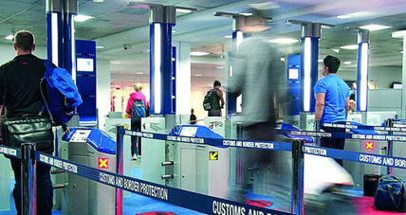
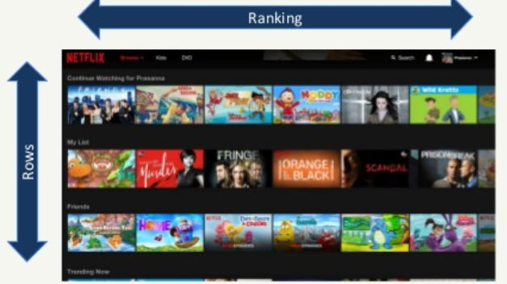
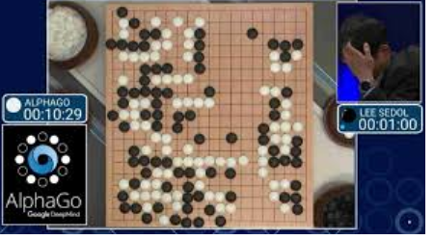
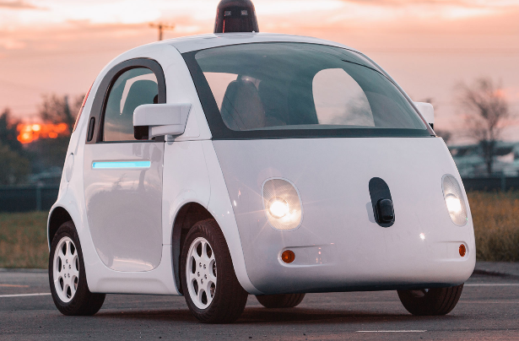
You hear about AI every day…

Slide 3
Machine Learning and AI is everywhere
They are more commonly used than you think. Let’s see three concrete examples
Retailer
Human Resource

Slide 4

[Retailer]
A retailer has an online shopping site:
Data collected:
Customer record
Product Information
Sales histories
Royalty data
…
ML can help to:
Sales prediction
Customer segmentation
Predictive inventory
Construct a Chabot
…

Slide 5
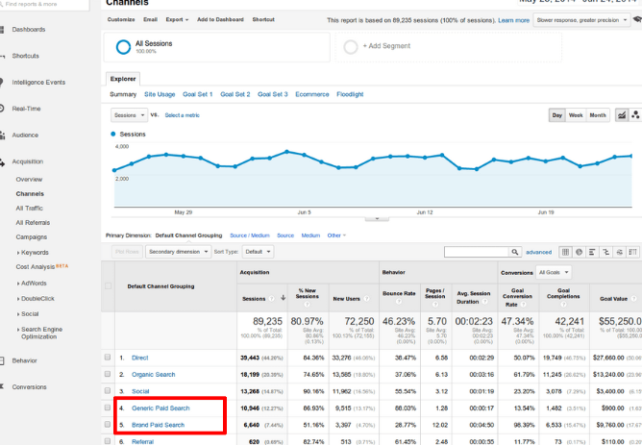
[Retailer]
A retailer may also use a customer tracking tool, such as Google Analytics:
Data collected:
Customer browse information (time and pages browsed)
Campaign response
ML can help to:
Recommendation system
Personalised email/campaign
Product correlations
Fine tuned recommendation system

Slide 6
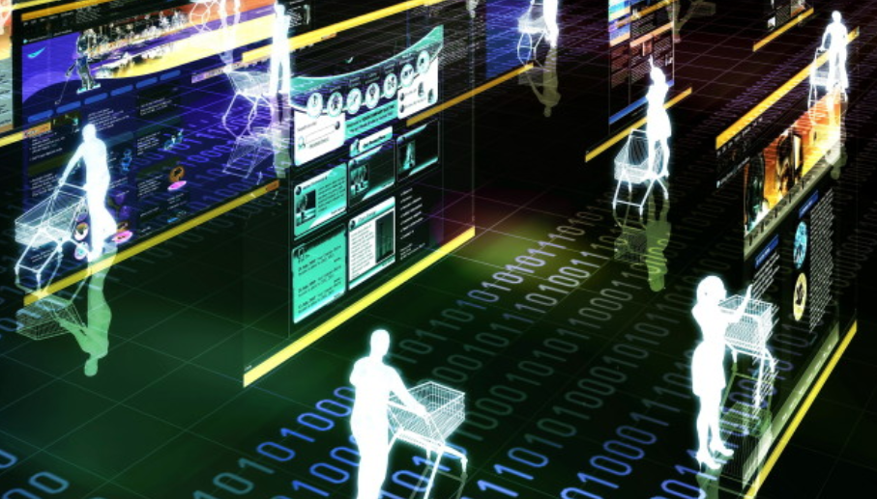
[Retailer]
A retailer may also have a physical store:
Data collected:
Shopping basket
Shopper trajectories
ML can help to:
Optimised Store design
Popular attraction spots

Slide 7
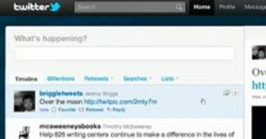
[Retailer]
A retailer may also monitor its social account
Data collected:
Tweeter messages about the retailer and its brands
Facebook review on this retailer
ML can help to:
Sentiment analysis about its customer experience
Predicting trends

Slide 8
In summary, ML & AI helps a [Retailer] to:
Understand customers better
Individualised/targeted marketing what promotion/product a customer may be most interested, personalised email
Create a positive experience market driven store layout design
Better and prompt marketing conversations using chatbot
Assist marketing professionals making decisions: which customer segment should spend what amount
….
Notes:
Most marketing teams have seemingly simple goals: identify your best customers, target prospects who look like them, facilitate a positive buying experience, and bring these prospects into your customer community.

Slide 9
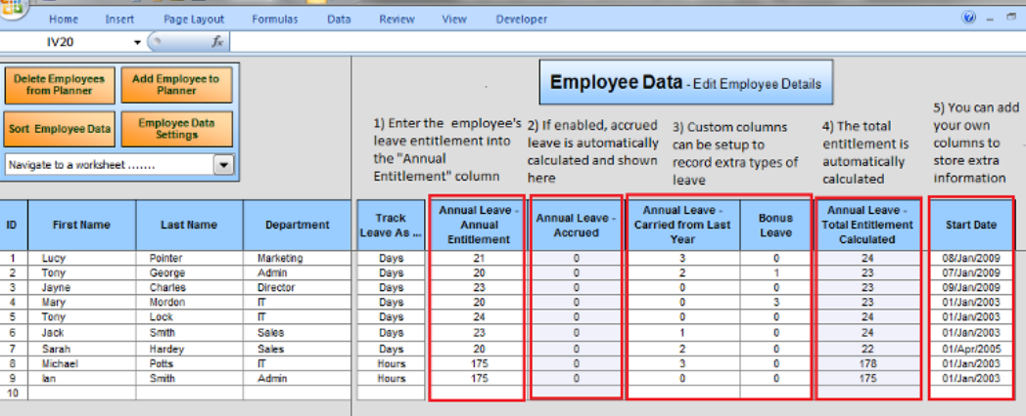
[Human Resource]
HR has a complete histories of each employee
Data collected:
Employee information
Job and tasks information
Department information
Evaluation report
…
ML can help to:
Performance indicator prediction
Career planning
Recommend trainings
…

Slide 10
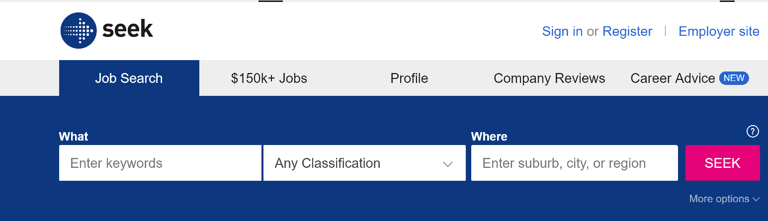
[Human Resource]
HR has source external job data
Data collected:
External Job sites data
…
ML can help to:
predict employee’s market value
Retention prediction

Slide 11
This course
Not trying to make you an AI nor ML expert in 3.5 hours, but instead:
Give you an overview of AI/Machine Learning (include Deep Learning)
Some of the very latest technologies in AI (include our own research @ UTS)
Fundamental techniques of ML: Regression, Classification and clustering algorithms
Get hands dirty: show some line of Python code
Where to go from here

Slide 12
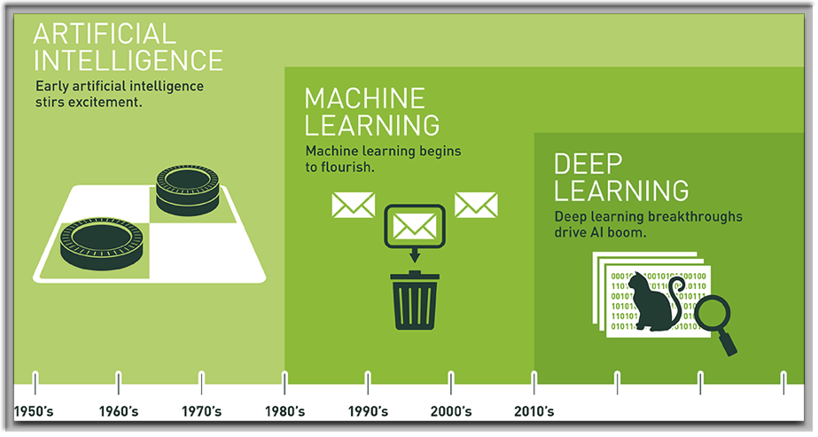
So what are the buzzword: AI, ML & DL?
a “biased” view from NVIDIA:
but not far from the truth

Slide 13
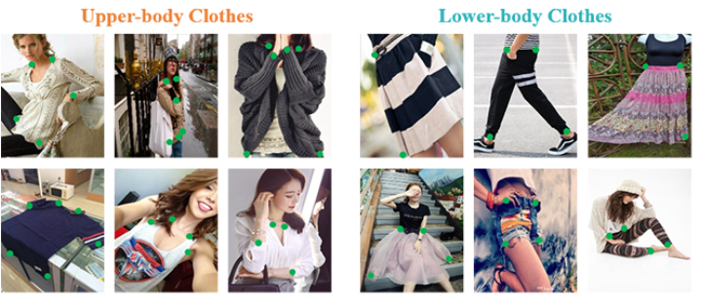
Some latest state-of-the-art technologies in ML
Detect cloth landmarks
Useful for predicting fashion trend
Notes:
These days, every business is in the data business, and in order to make better decisions, leaders need machine learning and analytics to find actionable patterns in the data.

Slide 14
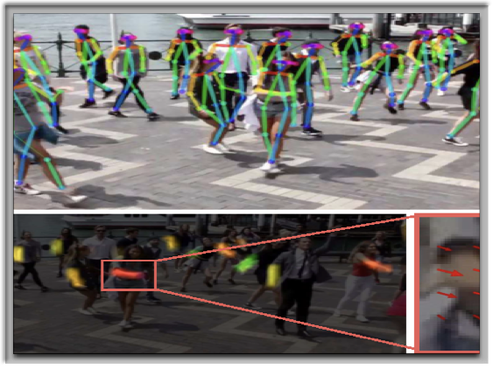
Real-time 2D pose estimation
Learning human pose: surveillance application
and sports

Slide 15
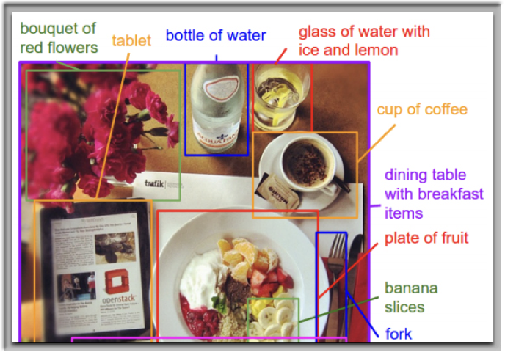
Real-time 2D pose estimation
Learn image labelling by parts

Slide 16
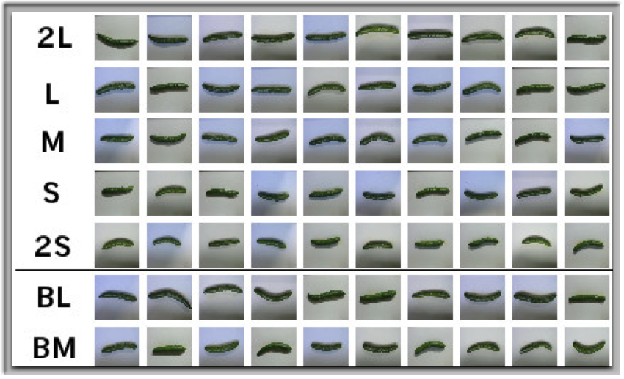
Cucumber sorting by Japanese farmer

Slide 17
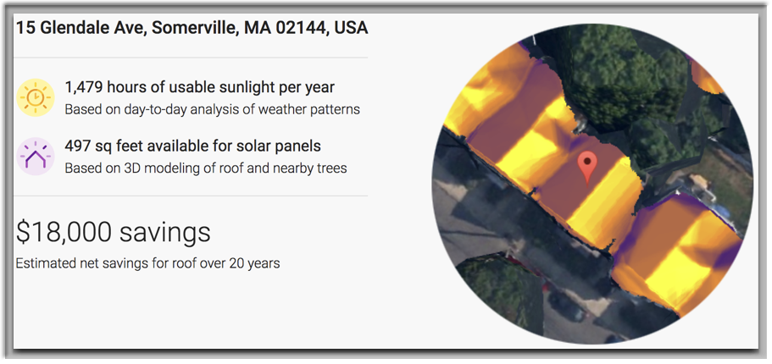
Google sunroof
Personalized solar savings estimator, powered by Google Earth imagery
Same type of technologies for estimating housing price
Can you think about another good application of house size detection on Google earth images?

Slide 18
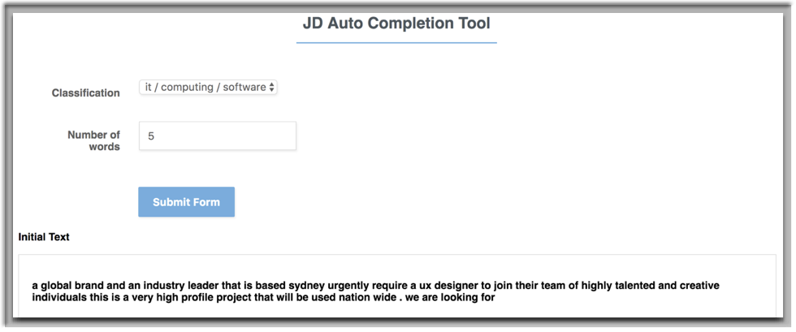
UTS::Deep Learning Automated Job Ad Generator
http://www.ridll.com/jobgenerator/
Notes:
We can use machine learning to analyse the frames in videos to determine what the plays are in a tennis match.

Slide 19
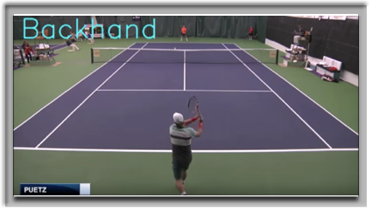

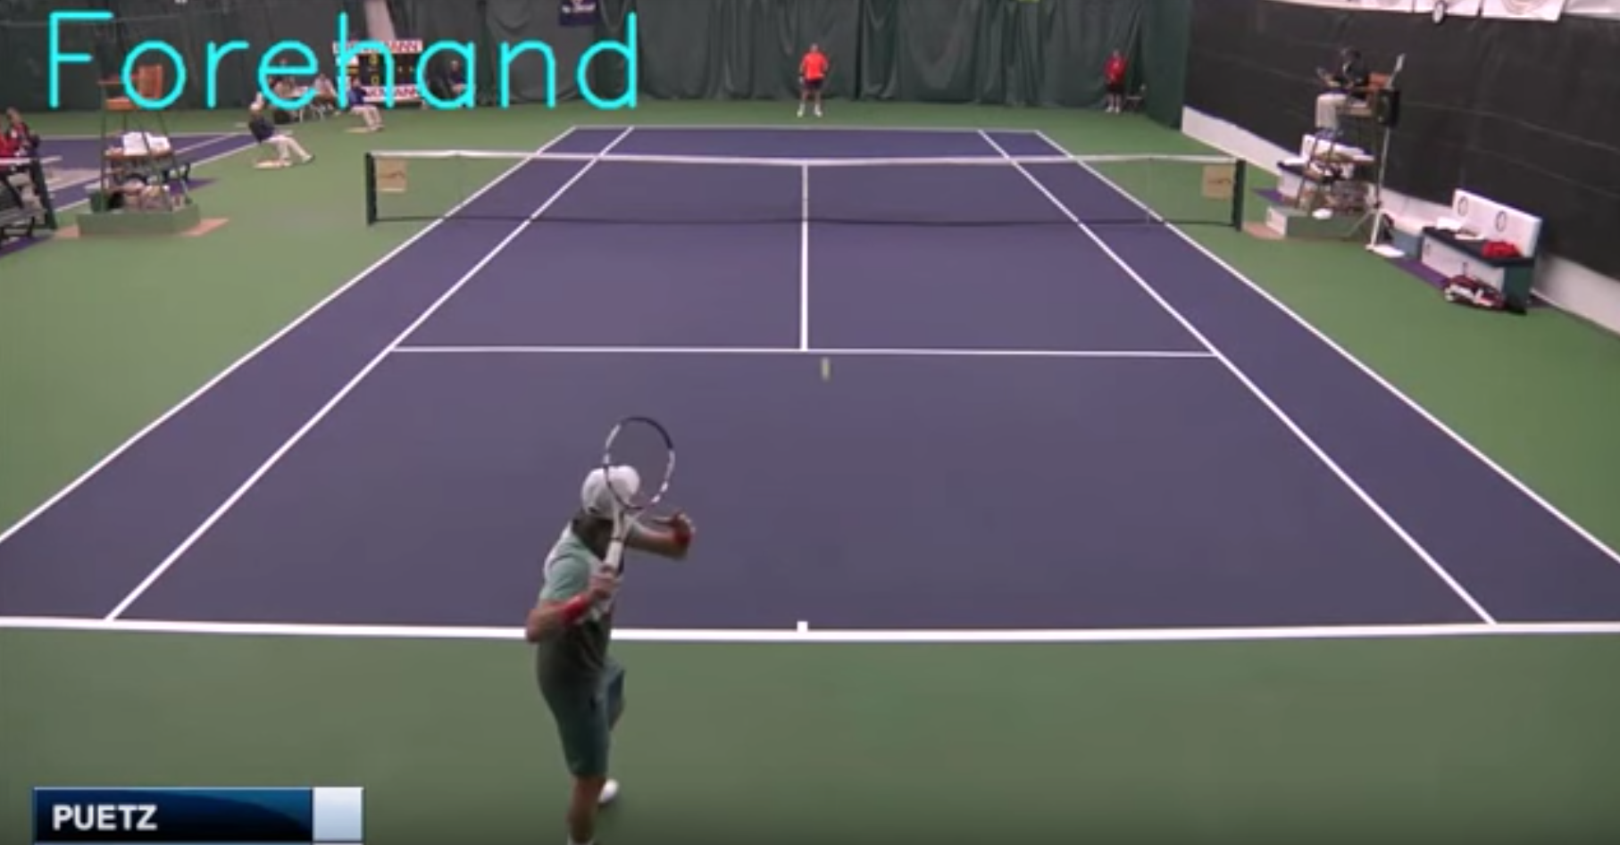
UTS::Deep Learning Automated Sports action recognition
Recognize 4 given action sequences in tennis
https://www.youtube.com/watch?v=MWAeBWFcWbg
a new version:
https://www.youtube.com/channel/UChLPFBeNlA0arPTrCor3tTg
Notes:
We can use machine learning to analyse the frames in videos to determine what the plays are in a tennis match.

Slide 20
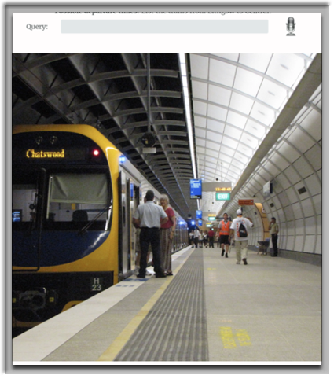
UTS::Deep Learning Automated natural language processing to SQL queries translation

Slide 21
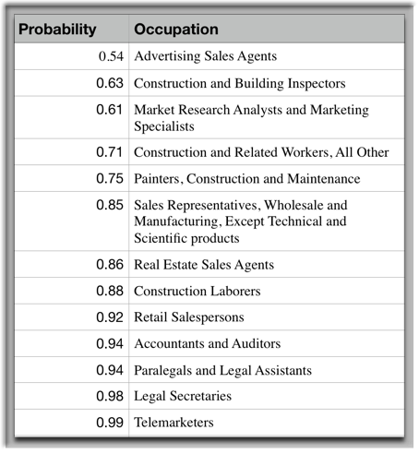
The impact AI/ML/DL will have on jobs in the future
Frey and Osborne 2014 report, Probability of computerisation of an occupation by AI
https://www.oxfordmartin.ox.ac.uk/downloads/academic/The_Future_of_Employment.pdf

Slide 22
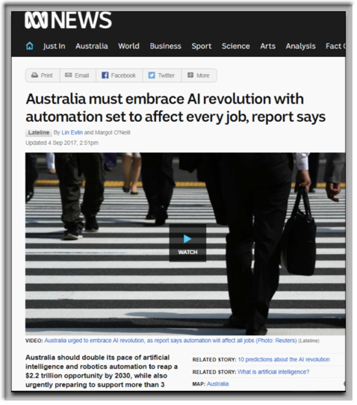
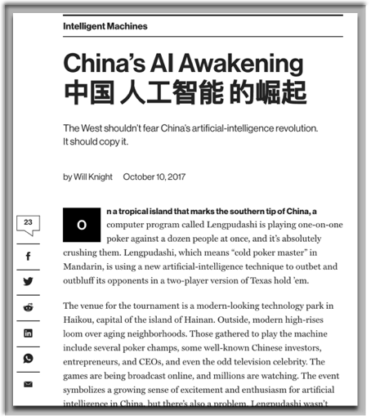
Is Australia prepared? How about elsewhere?
http://www.abc.net.au/news/2017-08-08/australia-must-embrace-ai-revolution-alphabeta-report/8774044
https://www.technologyreview.com/s/609038/chinas-ai-awakening/

Slide 23
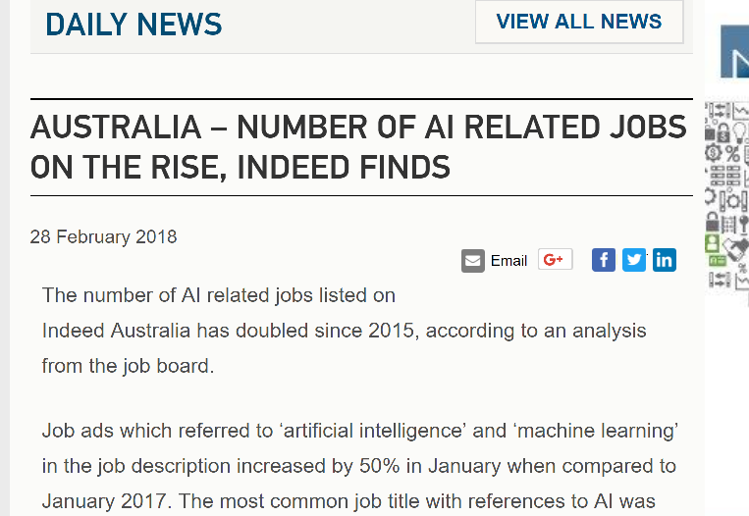

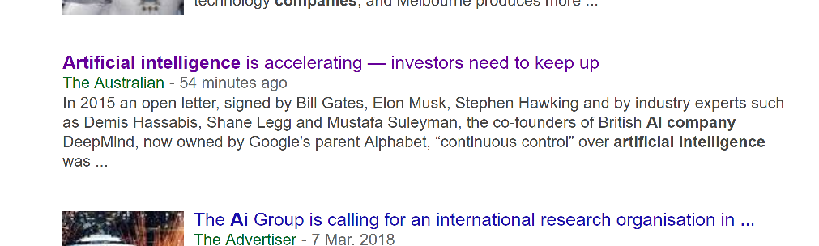
Is this a good news for machine learning employees?
Clearly, there is a skill shortage globally and in Australia

Slide 24
Moral of the story
It’s never been a better time to study AI, Machine learning and Deep learning!
Also it’s Time for some needy greedy technical stuff!

Slide 25


Supervised VS Unsupervised Learning
Supervised –There is a label (human supervision) associated with every data
Unsupervised – there is no label associated with the dataset

Slide 26
Supervised learning

Slide 27
Supervised Learning
Input | Output
1 | 2
2 | 3
4 | 5
6 | 7
12 | 13
15 | ?
You have input/output pairs, and lots of them! We call them training data
Now there is a new input, what may its output be?

Slide 28
Supervised Learning
Input | Model | Parameter | Output
1 | + | 1 | 2
2 |  |  | 3
4 |  |  | 5
6 |  |  | 7
12 |  |  | 13
15 |  |  | ?
We assume there is a model
The model should have a parameter that maps each input to its corresponding output (model)
This model and parameter is shared amongst all data (inference)

Slide 29
Supervised Learning
Input | Model | Parameter | Output
1 | + | 1 | 1
2 |  |  | 3
4 |  |  | 5
6 |  |  | 7
12 |  |  | 13
15 |  |  | ?
Here is key: once we know the model and parameter, we don’t need training data any more to predict output for new input

Slide 30
In reality…
Input | Model | Parameter | Output
1.2 | + | ? | 1.5
2.6 |  |  | 3.3
4.1 |  |  | 5.3
6.7 |  |  | 7.6
10.1 |  |  | 18.2
12.2 |  |  | 13.3
Models are never easily guessed
guessing the right model is the key!
Also, no model and parameters can give perfect output for every input
The key take way: given a model, we need to find a parameter that generates least amount of total discrepancies between predicted output and true output

Slide 31
Also in reality …
Input |  | Model | Parameter | Output
$ shoes | $ cloth | ? | ? | $ cosmetics
264.5 | 2231 |  |  | 345
324.1 | 2342 |  |  | 531
326.7 | 983.6 |  |  | 760
343.1 | 417.5 |  |  | 182
432.2 | 192.6 |  |  | 133.6
Input may be an array of numbers (vector)
Output can also be (usually not) vector
Guess the mode is difficult
Once the model is fixed, parameter can be worked out mathematically

Slide 32


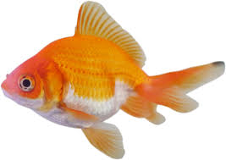
Also in reality even harder…
Input | Model | Parameter | Output
 | Sophisticated | Complicated and high dimensional | “Dog”
 |  |  | “Cat”
 |  |  | “Fish”
Input may complex such as text, image, graph …
Need sophisticated Model
Parameters are hard to obtain, and require clever mathematics

Slide 33
Supervised Learning - Regression or Classification
Regression - Predict results within a continuous output e.g. age, housing prices, stock prices, spending value
Classification - Predict results in a discrete output E.g.
- the type of animal an image belong to
- whether a customer is male or female

Slide 34
[Retailer] Regression example
Predict profitability of each customer
Input: - Age - Gender - Household count - Income range
Output: Profit per customer of running a marketing campaign
Notes:
During campaign management, you often need to calculate how much profit per customer you’re going to make before executing the campaign. You wouldn’t want advertising costs larger than profits right? So this is where regression analysis can help. By using customers’ age, gender, household and income range, you can predict how much they are willing to spend on certain products.

Slide 35
[Retailer] Regression example
Predict ice cream sales volume
Input: - Base price - Time of day - Weather - Loyalty card discounts
Output:
total ice cream sales

Slide 36
[HR] Regression example
Produce recommend salary increase
Input
number of years of service
qualification score
Job type Market value
Performance review score
Output
Salary increase

Slide 37
[Building] Regression Example
Input:
land size (m²)
Floor size (m²)
Number of bedrooms
Number of bathrooms
Number of car space
standardized sale price of the suburb
How old is the house
Output: - House’s sale price

Slide 38
[Retailer] Classification example
Predict if a customer will be interested in the new product (hence to decide if he/she should be included in the marketing campaign)
Input: - Age - Gender - Household count - Income range
Output: interested (1) or not interested(0)
Notes:
During campaign management, you often need to calculate how much profit per customer you’re going to make before executing the campaign. You wouldn’t want advertising costs larger than profits right? So this is where regression analysis can help. By using customers’ age, gender, household and income range, you can predict how much they are willing to spend on certain products.

Slide 39
[Retailer] Classification example
recommend if a brand of ice-cream be included on the shelf
Input:
Base price
Weather
Sales history of this brand of ice-cream
Average income of population around the physical store
Output:
On-shelf (1) or not on-shelf (0)

Slide 40
[HR] Classification example
Predict if an employee may resign in the next six months
Input
number of years of service
qualification score
Job type Market value
Performance review score
Current pay
How recent was the last LinkedIn profile change
Output
Yes (1) or No (0)

Slide 41
[Building] Classification Example
Predict if a house will be sold in the next 6 weeks
Input:
The asking price
Time on the market
land size (m²)
Floor size (m²)
Number of bedrooms
Number of bathrooms
Number of car space
standardized sale price of the suburb
How old is the house
Output: Sale (1) or No-sale (0)

Slide 42
Under many settings
Same input
but different outputs
one correspond to regression
another correspond to classification

Slide 43
Regression and classification Energy consumption/efficiency of a building
Input:
Building area
Window U-value
Wall U-value
…
Output (Regression)
How much energy is the building consuming? E.g. 1500kW, 3000kW
Output (Classification)
Is the building energy efficient? (Y/N)
Notes:
There are some problems that may use the same attributes but could be either a regression or classification problem depending on the output desired. For example, if we wanted to know if a building was energy efficient, that would be a classification problem. The output would be either the building is energy efficient or it isn’t. If we wanted to find out how much energy the building consumed, it would be a regression problem.

Slide 44
Regression and classification Energy consumption/efficiency of a building
Input:
every subject marks
Research time spent
intern experience
Output (Regression)
predicted grad salary
Output (Classification)
Will study honours? (Y/N)
Notes:
There are some problems that may use the same attributes but could be either a regression or classification problem depending on the output desired. For example, if we wanted to know if a building was energy efficient, that would be a classification problem. The output would be either the building is energy efficient or it isn’t. If we wanted to find out how much energy the building consumed, it would be a regression problem.

Slide 45
Data types
Question: What is the difference between these two categorical output:
User ratings of online products: 1,2,3,4,5
Email domains:
1 = @gmail.com, 2 = @uts.edu.au, 3 = @hotmail.com,
4 = @amazon.com, 5 = @yahoo.com

Slide 46
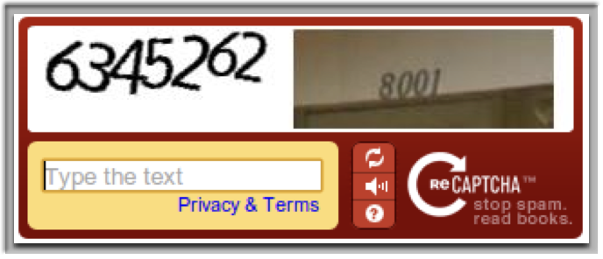
Crowdsourcing: free labelling
Labelling data is too expensive
Can we get it done cheaply?
Question is What if the majority of people input random answers? Will it still work?

Slide 47
Supervised learning Models
Many models can be applied:
For regression: Linear, Polynomial, Ridge, Lasso Regression, ElasticNet, Gaussian Process , Decision Tree . . . many more
For classification: Neural networks, Support Vector Machine, Multinomial Logistic Regression (Softmax), Decision Tree, Random Forest . . . many more
For details, check out my machine learning notes!

Slide 48
How can you tell if your classifier is accurate?
Split your training data into “training” and “testing”
Input |  | Model | Parameter | Output
$ mid-term | $ assignment | ? | ? | $ pass exam?
74 | 13 |  |  | N
56 | 54 |  |  | Y
58 | 91 |  |  | Y
92 | 81 |  |  | Y
43 | 86 |  |  | N
81 | 91 |  |  | Y
46 | 35 |  |  | N
Split your training data into “training” and “testing”
Should we repeat this multiple times?

Slide 49
Classification accuracy
Classification accuracy: Percentage of records correctly identified
The following shows accuracy of 6/8
Input |  | True output | Predicted output
mid-term | assignment | pass exam | pass exam
74 | 13 | N | N
56 | 54 | Y | N
58 | 91 | Y | Y
92 | 81 | Y | Y
43 | 86 | N | Y
81 | 91 | Y | Y
46 | 35 | N | N

Slide 50
Classification accuracy: skewed data
What happens when the data set is skewed, i.e., there is a class imbalance?
For example, a retailer website plans to roll out an expensive campaign for any shopper whom may spend more than $2,000 in the next season. To do this, it requires the ML expert to develop a model to predict which shopper is in this category.
From historical dataset, it is known that there is only 0.1% of all shoppers fall into this category.
What if classification accuracy is used under this setting?

Slide 51
TP, TN, FP, FN
TP (True positive): Classifier shows it is positive, it is really positive
TN (True negative): Classifier shows it is negative, it is really negative
FP (False positive): Classifier shows it is positive, it is really negative
FN (False negative): Classifier shows it is negative, it is really positive

Slide 52
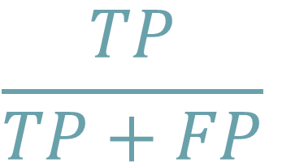
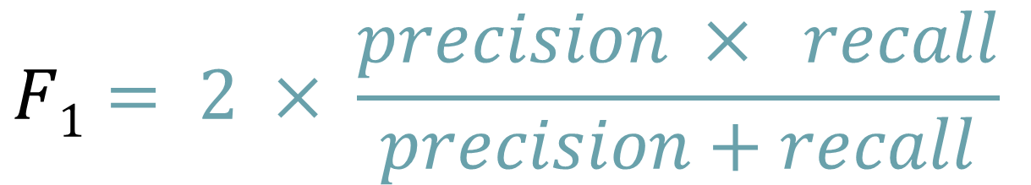
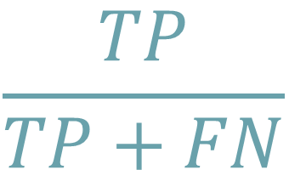
Precision, Recall and F1 score
$$\frac{TP}{TP+FP}$$
Precision or positive predicted value:
Recall or sensitivity:
$$\frac{TP}{TP+FN}$$
$$F1= 2 × \frac{precision × recall}{precision+recall}$$

Slide 53
Un-Supervised learning

Slide 54
Unsupervised learning
Not all dataset came with a labels/output
For many dataset, the labels may not even necessary having a straight forward meaning
For example: in customer segmentation – what is the meaning for each customer segment?

Slide 55
Some models in unsupervised learning
Clustering k-means and mixture models
Latent Dirichlet Allocation (has been hot)
Autoencoders
Generative Adversarial Networks (very hot!)

Slide 56
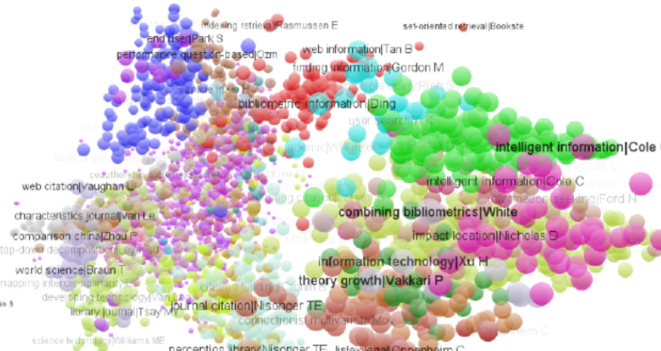
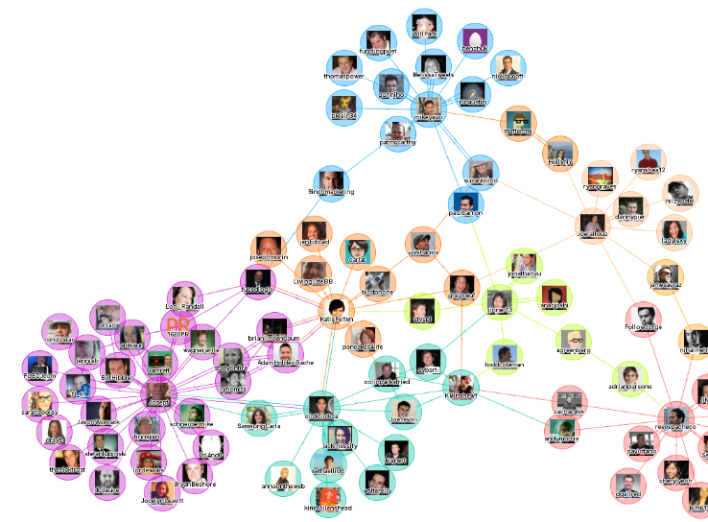
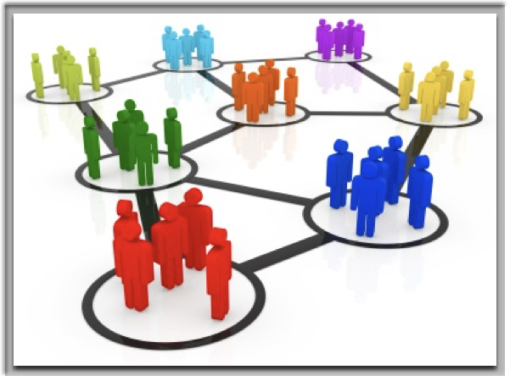
Application of Clustering
Social networks
Image credit: TouchGraph.com
Document clustering
Image credit: ResearchGate
Customer segmentation
Image credit: Smart insights

Slide 57
Simplest Clustering algorithm: K-means
STEP 1: Place K points into the space represented by the objects that are being clustered. These points represent initial group centroids.
STEP 2: Assign each object to the group that has the closest centroid
STEP 3: When all objects have been assigned, recalculate the positions of the K centroids.
Repeat Steps 2 and 3 until the centroids no longer move.

Slide 58
Limitation of K-means
assumes variance of the distribution of each attribute is spherical,
all variables have the same variance;
probability for all k clusters is the same, i.e., each cluster has roughly equal number of observations
Solution: using a (Gaussian) Mixture Model

Slide 59
Exercise on Supervised (regression and classification)/Unsupervised
Looking at Microsoft https://how-old.net/ it was trained using images of people with known ages
Obtain segments of passenger traveling behaviours from Transport Survey Data
Given a video sequence: separate any arbitrary (moving) foreground from its background assuming background pixels varies less than the foreground (we compute statistics of the background first)
Having a historical relationship between material consumption and labour hours, develop model to predict the labour hours for the material consumption in the future.
Develop world’s best image-based object recognition system
Looking at Experian Mozaic http://www.experian.com.au, which train and categorize customers (with some data feature extraction) into a set of predefined categories.

Slide 60
Machine Learning projecT

Slide 61
Three layer approach: Layer 1: Application
Business Analyst plays a significant role in this layer
BA defines business’ problem, obtain business value
Domain specific knowledge is essential
Each project is different: a BA will be needed at the initial phase for each individual project.
They generally have a broad understanding of machine learning, and its capabilities.

Slide 62
Three layer approach: Layer 2: Model Formulation
Data Scientist plays a main role in here.
Transforms the business problem into a mathematical framework.
This is usually the task of a data scientist who has knowledge on applying machine learning.

Slide 63
Three layer approach: Layer 3: Solver
Machine Learning practitioner/researcher plays a major role in here
Now that we have a model, we an solve these equations.
Often, a generic solver may not be appropriate, especially when the data is BIG.
This is why they need to have research level knowledge on machine learning and mathematics to make the solutions workable.

Slide 64
Traveller’s tap-on time modelling
Layer 1: Application
From OPAL data, the business wants an estimate on the probability of passenger taps on at central station at various times (e.g., what is the probability of someone taps on at central at 8:15am?)
Layer 2: Model Formulation
Model all passenger tap on times using Bi-modal Gaussian Mixture Model (GMM)
Layer 3: Solver
Solve GMM using expectation-maximization;
see one_d_opal_simulated.m

Slide 65
Hotel recommendation system
Layer 1: Application
an online hotel business has a database containing every user’s rating of their stayed hotels the marketing team wants to know which hotels to recommend to individual user in a promotional email (customized emails)
Layer 2: Model Formulation
data scientists decide to build a recommendation system using Non-Negative Matrix Factorization (NNMF) algorithm
Layer 3: Solver
there are many ways to solve NNMF, but the team decide to use Gradient Descend, because of the relative small size database

Slide 66
Learning analytics system
Layer 1: Application
hypothetically, UTS decides to build the world’s best learning analytic system: it takes into consideration of the student’s histories of studies and their interest, then it produces a “future study plan” deems to be best fit for each and every student and of course, they asked Richard’s team to conduct this work
Layer 2: Model Formulation
Richard’s team decides to base this model using a modified Recurrent Neural Network (RNN).
Layer 3: Solver
learn all the parameters of RNN using standard back-propagation.

Slide 67
Some conclusion remarks

Slide 68
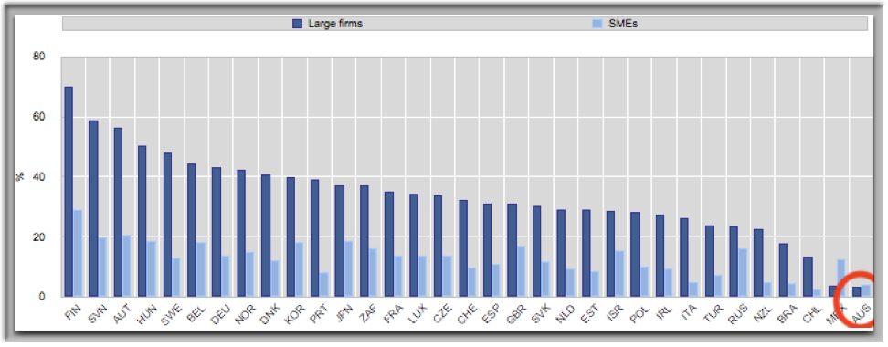
OECD chart for collaboration between researches and businesses
OECD, based on Eurostat (CIS-2010) and national data sources, June 2013.

Slide 69
List of world leading AI and Machine Learning scholars employed by companies
Geoffery Hitton, Google and DNNresearch Inc, USA
Richard S. Sutton, head academic advisor to Royal Bank of Canada, Canada
Michael I Jordan, technical adviser to the Ant Financials, China
Yann Lecun, Director of AI Research at Facebook,USA
Zoubin Ghahramani, Uber’s Chief Scientist,USA
Fei-Fei Li, Chief Scientist of Artificial Intelligence & Machine Learning, Google Cloud USA
Daphne Koller, Chief Computing Officer, Calico Labs USA
Andrea Frome, Director of Research, Clarifai UK
Carol Reiley, Co-Founder & President, Drive.ai USA
Hua Wu, Technical Chief, Baidu Natural Language Processing (NLP) Team China
Ayse Naz Erkan, Staff Data Scientist, Twitter USA

Slide 70
shorten ML knowledge gap between industry and academia
problem almost every data strategist is facing today is, how to make the most out of the booming opportunities in machine learning:
when it comes to esoteric nature of data science, many corporate leaders maybe missing out on the full benefit, because they may be unsure of what machine learning is and what itcan do for them
Often, it can be as simple as fearing the unknown holding corporate leaders back from embarking on machine learning projects with specialists
academia can help in many areas. For example, University can help industry to answer some of the questions (next slides)

Slide 71
“Is the product a really high tech one?”
ML vendors tries to “sell” machine learning/AI solutions to industries every day.
I how much technologies really is in its product?
I for example, vendors may sell a “cutting-edge speech recognition” solution using a wrapper around off-the-shelf Google or Amazon cloud engine

Slide 72
“am I hiring the right data scientist?”
produce a “machine learning demo” is much easier today than it has ever been
there are many open-source stuff out there on Github! - simply run them will produce an “impressive demo”
machine learning is new to a lot of data strategists, therefore how can a corporate pick the right candidate, i.e., someone knowledgeable in ML versus someone just ran the code from Gibhub two days ago.

Slide 73
“am I using the ML tool appropriately?”
if someone was to write a computer software, you know when something is wrong: for example, website crashes
ML algorithm will “always” run and always produce some results
therefore, it’s vitally important to make sure the results are meaningful and/or correct assumptions, algorithms are used

Slide 74
Some resources
Prof Richard Xu’s machine learning notes and source code
https://github.com/roboticcam/machine-learning-notes
Andrew Ng’s Machine learning MOOCS
https://www.coursera.org/learn/machine-learning

